Slide 1


Introduction to Cardiorespiratory Assessment
Puja Trivedi
Highly Specialist Respiratory Physiotherapist
Harefield Pulmonary Rehabilitation Department

Slide 2
Learning Outcomes
By the end of the session, students should be able to:
Describe and justify a subjective assessment of a cardiorespiratory patient
Describe and justify an objective assessment of a cardiorespiratory patient

Slide 3
Assessment Aims
To define the patient’s problems accurately, by subjective and objective assessments
Accurate assessments required to develop effective treatment plans
Theoretical knowledge
  Assess effectiveness in relation to problem and goals regularly

Slide 4
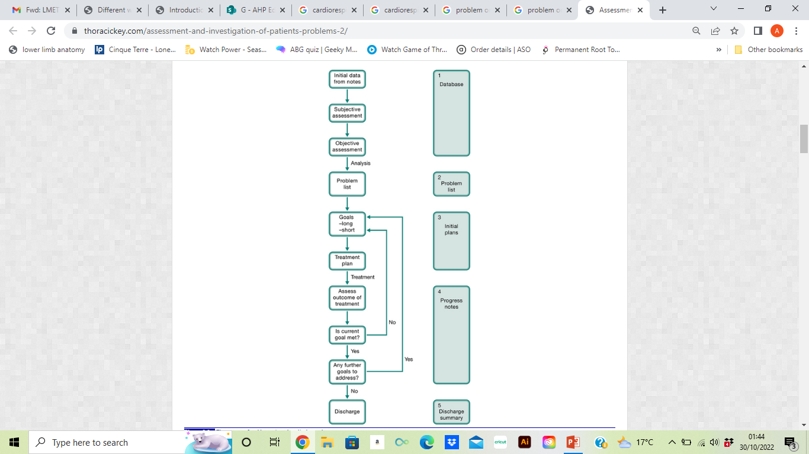
Problem Orientated Medical Records
Difficult to develop appropriate plan without accurate assessment
Pryor (2011)

Slide 5
Assessment Components
Data from alterative sources:: Medical notes, handovers,
Subjective Assessment
Interview style assessment
Information re symptoms, feeling, perceptions and concerns
Objective Assessment
Observable and measurable data and signs.
obtained through observation, physical examination and diagnostic testing
Auscultation
Palpation
Imaging
Lung function testing
Exercise assessments
Notes:
A symptom is a manifestation of disease apparent to the patient himself, while a sign is a manifestation of disease that the physician perceives. The sign is objective evidence of disease; a symptom, subjective. Symptoms represent the complaints of the patient, and if severe, they drive him to the doctor's office. If not severe, they may come to light only after suitable questions. The patient perceives, for example, subjective pains and discomforts [Doctor, I have a bad headache], or disturbances of function [Doctor, I can't move my arm the way I used to], or some simple appearance [Doctor, I have had this rash for the past ten days and I'm worried about it].

Slide 6
Symptoms | Signs
Breathlessness (dyspnoea) | Sounds on auscultation
Cough | Palpation
Sputum | Cough quality / productivity
Chest tightness | O2 saturations
Wheeze | Blood Pressure
Pain | Heart Rate
Reduced exercise capacity | Imaging ( Xrays, CT’s)
Change in weight | Spirometry / Peak flow
 | Blood gases
 | Level of consciousness
 | Work of breathing
 | Use of supplementary O2
* Some cross over can occur

Slide 7
Information Gathered from Other Sources
Details gathered before reviewing the patient should include:
Reasons for admission / presentation
Understanding of medical history
Social History
Drug history
Reviewing relevant investigation: Chest x-rays, CTs, bloods results, ABG
Observation charts
The above can be achieved by:
Reading notes ( recent / previous documentations / referral letters
Liase with MDT

Slide 8
Subjective Assessment
Information gathering / interview with the following aims:
Confirm information previously gained
Fill gaps of information
History of Presenting Complaint (HPC)
  Summary of current problems, history of onset
Past Medical History (PMH)
Drug History
  Current medication (including dosage). Allergies to be noted
Social History
  Level of function / support, home layout, occupation, hobbies, Smoking history
Exercise Tolerance
Previous physiotherapy intervention
Test Results
  what significant findings re available: sputum, blood tests, spirometry
Notes:
Social hx – provides picture of patient social situation

Slide 9
Subjective Assessment
Breathlessness ( Dyspnoea)
Cough
Sputum
Haemoptysis
Wheeze
Chest pain
Duration
Severity
Pattern
Associated Factors
Considerations:
Can the patient provide this information directly?
Ascertain baseline information vs Current status
Notes:
Breathness
– Subjective awareness of an increased work of breathing
Dominant symptom of cardioresp disease including: COPD, Asthma, Bronchiectasis, chest infection, Pneumonia, heart failure
Most easily ax through enquire re level of function or objective mesasuremenrts

Slide 10
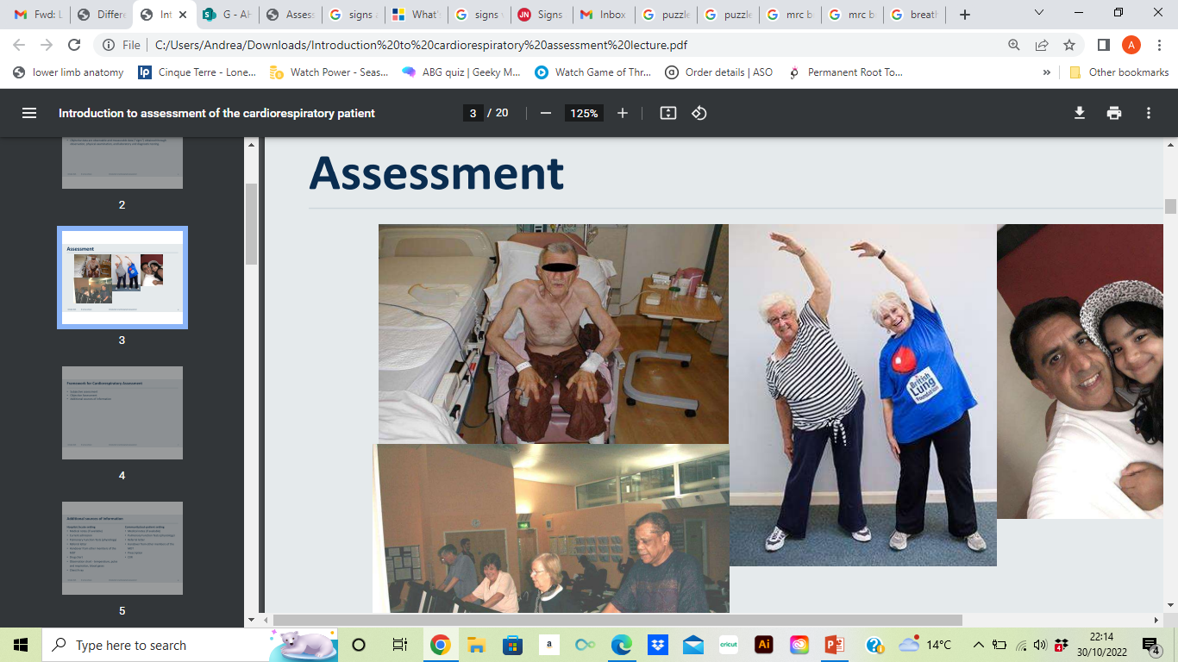
Breathlessness
Subjective awareness of an increased work of breathing
Dominant symptom of cardiorespiratory disease
Example Assessment Questions
Do you experience shortness of breath (SOB)?
When do you experience SOB?
- Breathlessness when lying flat –Orthopnea
- Do you feel breathless at night?- Paroxysmal Nocturnal Dyspnea?
Which activities cause SOB?
Have there been a recent changes to your SOB?
What eases your SOB?
How does SOB impact day to day living
Notes:
including: COPD, Asthma, Bronchiectasis, chest infection, Pneumonia, heart failure

Slide 11
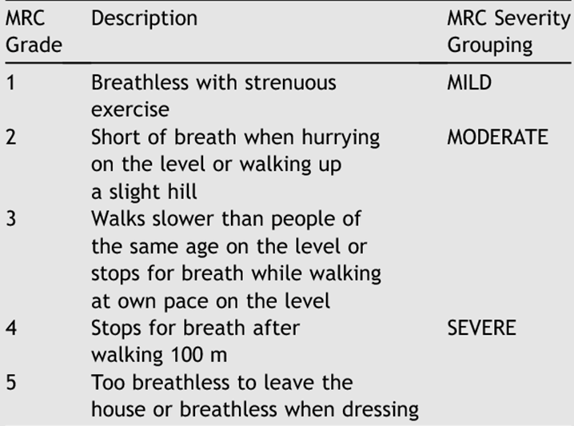
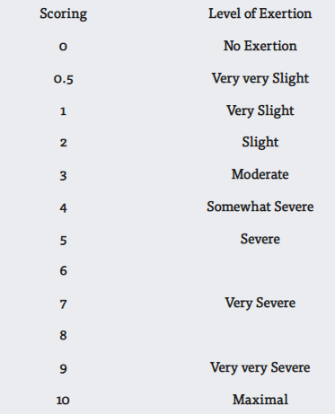
MRC Scale of Breathlessness
BORG Scale

Slide 12
Cough
Protective reflex
Helps remove sputum or foreign body from airway
Can be difficult to clarify / quantify symptom
Example Assessment Questions
Do you cough?
How frequently?
Has their been a change to your cough?
What usually triggers your cough?
Is it dry or productive?
How able are you to clear effectively?

Slide 13
Sputum
Changes can indicate new infection
Hemoptysis – Presence of blood in sputum
- Frank blood VS Streaking
Example Assessment Questions
Do you bring up sputum?
How effective is it to clear?
How normal is that for you?
What is the Colour? Consistency? Quantity per day? Smell?
What are your usual airway clearance techniques?
Do you see blood in your sputum?
Notes:
If possible, several sputum samples should be collected at baseline followed by 3 to 6 monthly samples.
It is desirable for children and adults to learn how to expectorate sputum from their lungs to:
document microbiology
direct antibiotic treatment
assist with the monitoring of the condition
Patients with chronic infectiove lung disease often recurrent haemoptyses

Slide 14
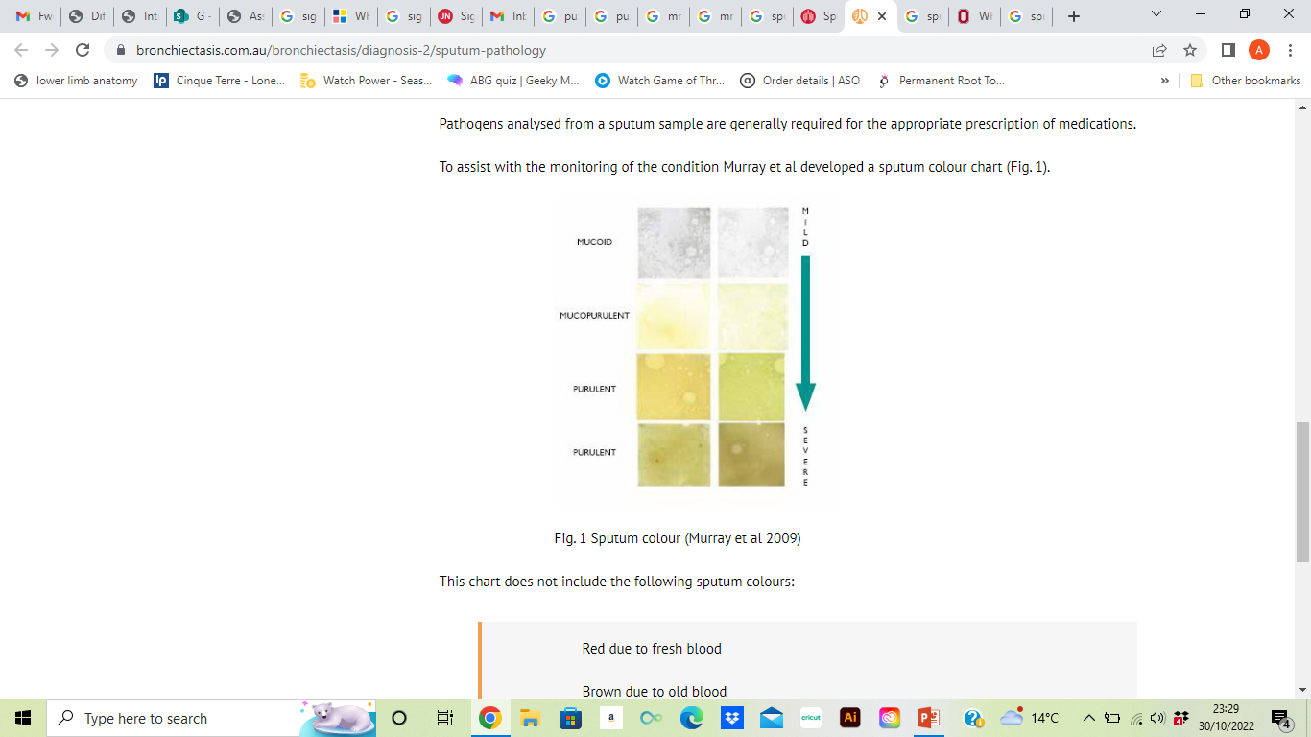
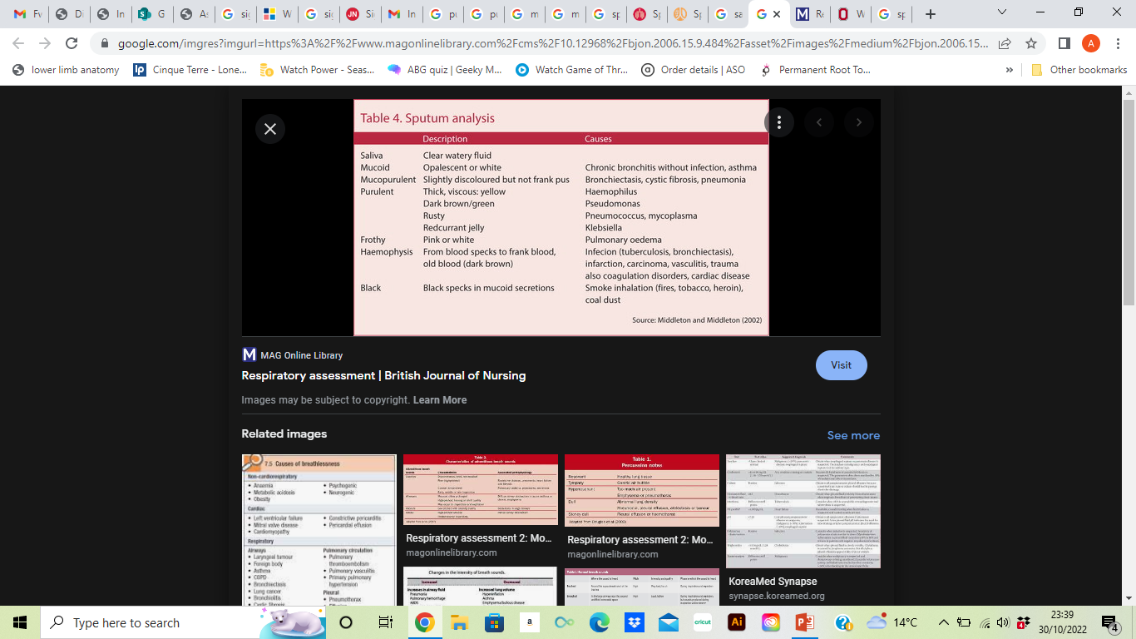
Sputum Analysis
Murray et at ( 2009)
Simpson (2013)

Slide 15
Chest Pain
Pulmonary: Pleurisy, embolism, Pneumothorax
MSK: rib fracture, muscular
Cardiac: Pericarditis. Ischemic heat disease
Mediastinum: Aortic aneurysm, esophageal, Mediastinum shift
  Example Assessment Questions
Do you experience chest pain?
When does it occur?
Where is this located?
What are the triggers / improves pain
Notes:
MSK – Chest wall pain
Well localized, exacerbated by chest or arm movement
Pleuritic
Inflamattion of parital pleura
Severe, sharp stabbing pain
Tracheititis:
Buring cental chest pain
Agged by breathing
Pneuomthorax

Slide 16
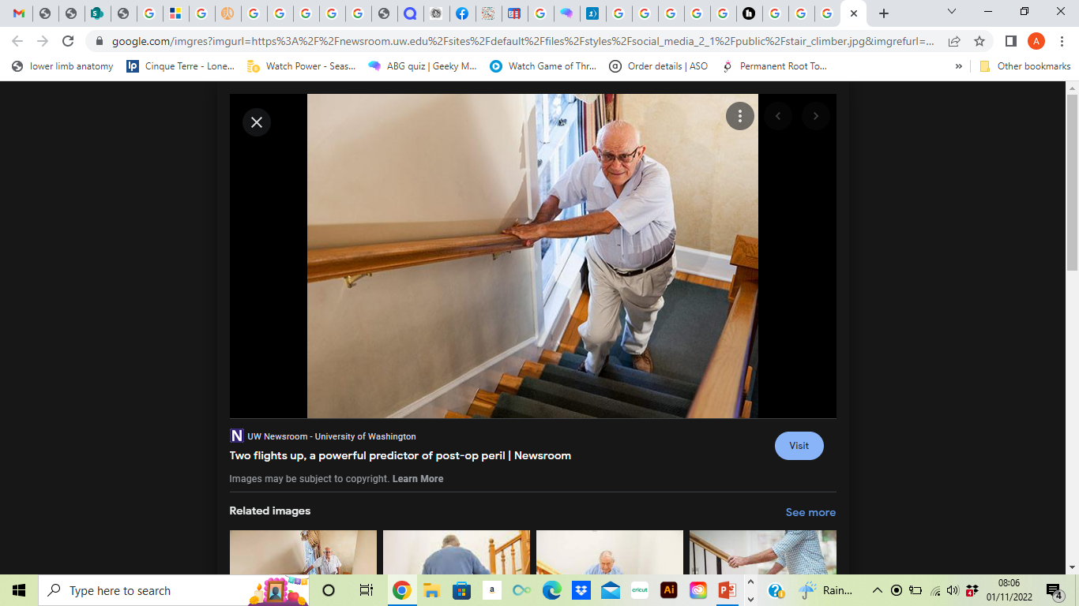
Subjective Assessment
Functional Ability
Exercise capacity
Ability to complete stairs
Home layout
Any carers?
Incontinence
  Chronic cough leading to pelvic weakness

Slide 17
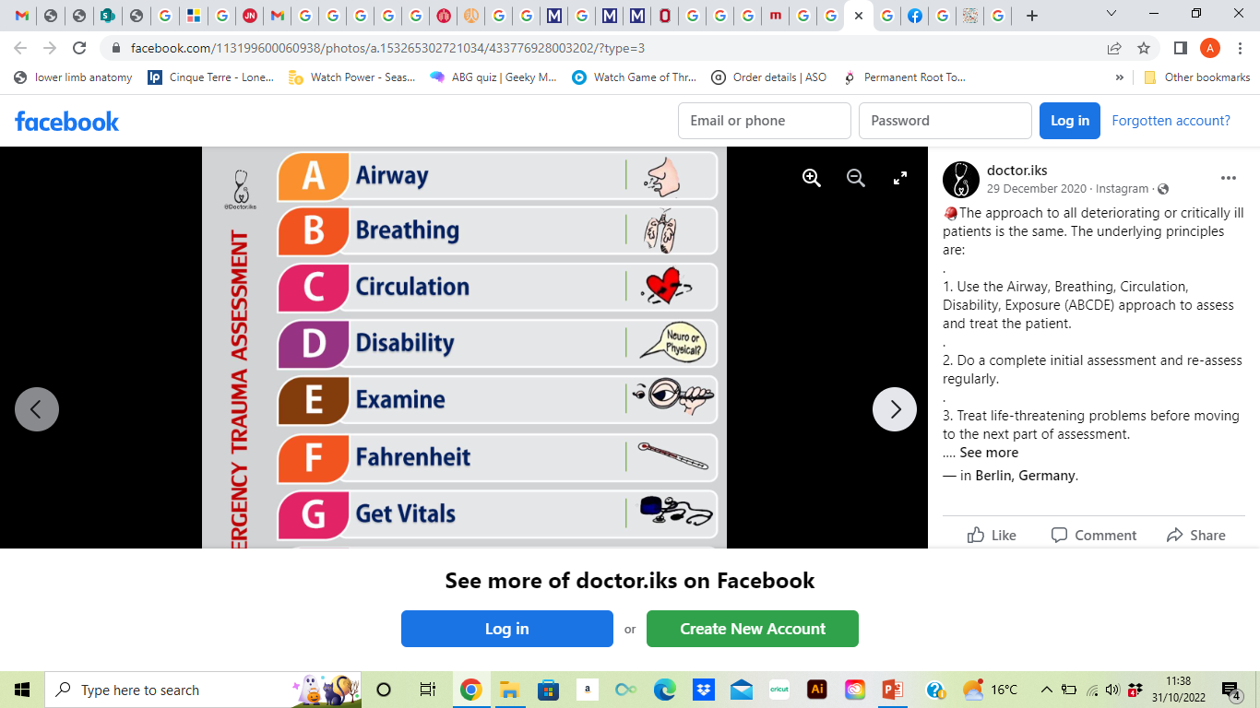
Objective Assessment

Slide 18
Objective Examination
Observation
Measure
Palpate
Listen

Slide 19
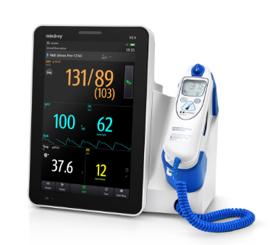
Vital Observations
Level of consciousness
  GCS / NEWS score
Heart Rate ( HR) 60-100 bpm
  Blood Pressure (BP) - 120/80
  Respiratory Rate ( RR)- 12-16 bpm
  Spo2 – 98-100%
Temperature
Important to check before and after any intervention
Feedback any significant changes to nurse or Dr
Notes:
Note some cardiac medication can alter heart rate: bronchdialors: increase. Beta blockers: decrease
Athletes more likely to have lower resting heart rates
Fever, anziety, hypozia can drive higher heart rates
Note medication – are you taking / had on time
Posturatal hypotensiob

Slide 20
Airway
Airway (is airway own or artificial)
Main artificial airways:
  nasopharyngeal – tube in the nasal passage
  oropharyngeal – tube in the mouth
  tracheostomy – opening the neck and placing tube in windpipe

Slide 21
Breathing Assessment: Measurement
Measure
RR - Normal Range: 12-16bpm
Oxygen Saturations Normal:>98% O2 sensitivity < target range ie 88 – 92%
Lung function Testing - Spirometry vs Peak flow
Breathlessness - Borg, MRC
Arterial blood Gases ( AGB’s)
Fraction of Inspired O2 ( Fio2)
Chest Imaging ( X-rays. CT’s)
Notes:
Respiratory rate – average adult RR is 12 breaths per minute, this can either be counted by you or will be on the obs machine
SpO2 – also known as oxygen saturation, will be found on the obs machine. Normal values: 95-98% (For healthy individuals)
FIO2 – defined as the concentration of oxygen that a person inhales. The air that we inhale on a day to day basis is made up of 21% of oxygen, this will change if the patient is placed on oxygen
ABGs (please refer to previous blog about ABGs)
Chest x-rays – look at these to determine any abnormalities within the lungs
Ascultation – use a stethoscope to listen to breath sounds throughout lungs (blog soon to be released about this)

Slide 22
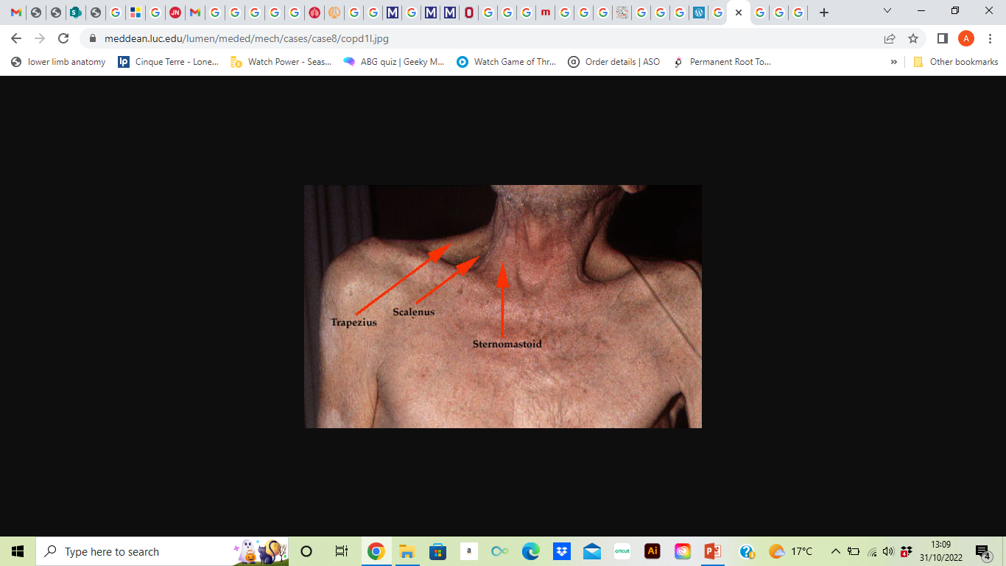
Breathing
Observation:
Speech - length of sentences
Assessory muscles usage
Pursed lip breathing
Breathing Pattern
Chest wall shape

Slide 23
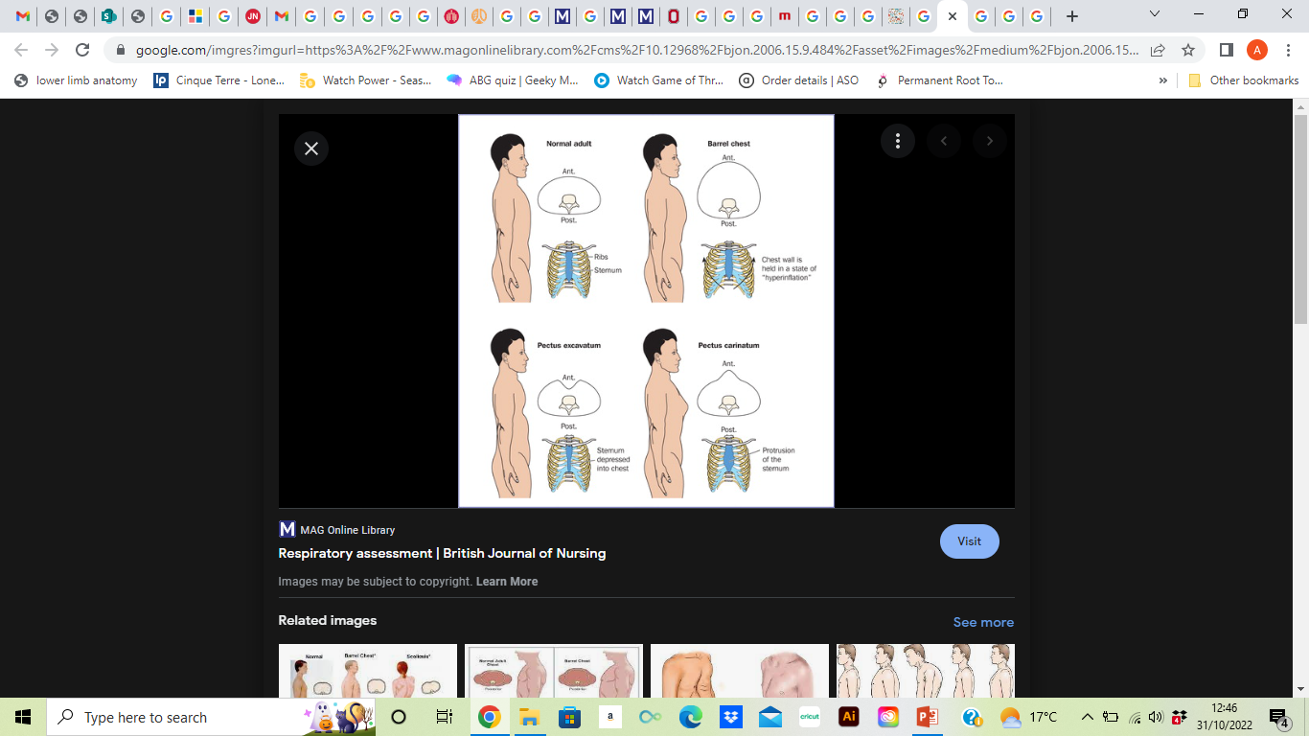
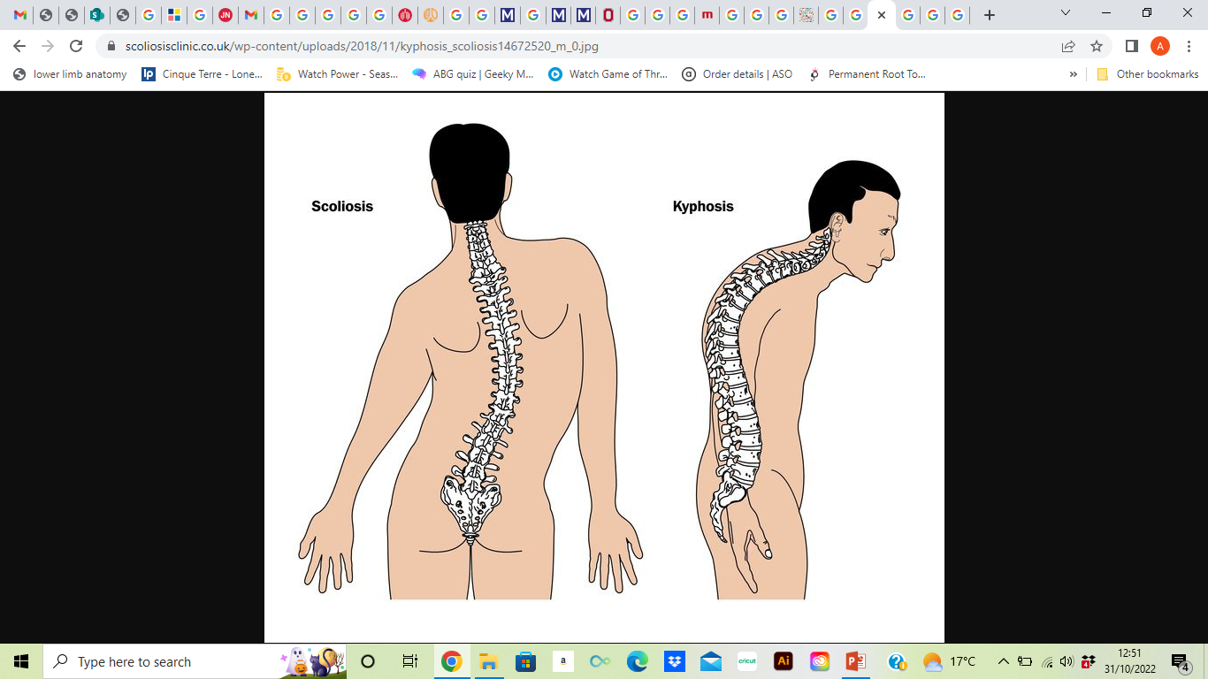

Slide 24
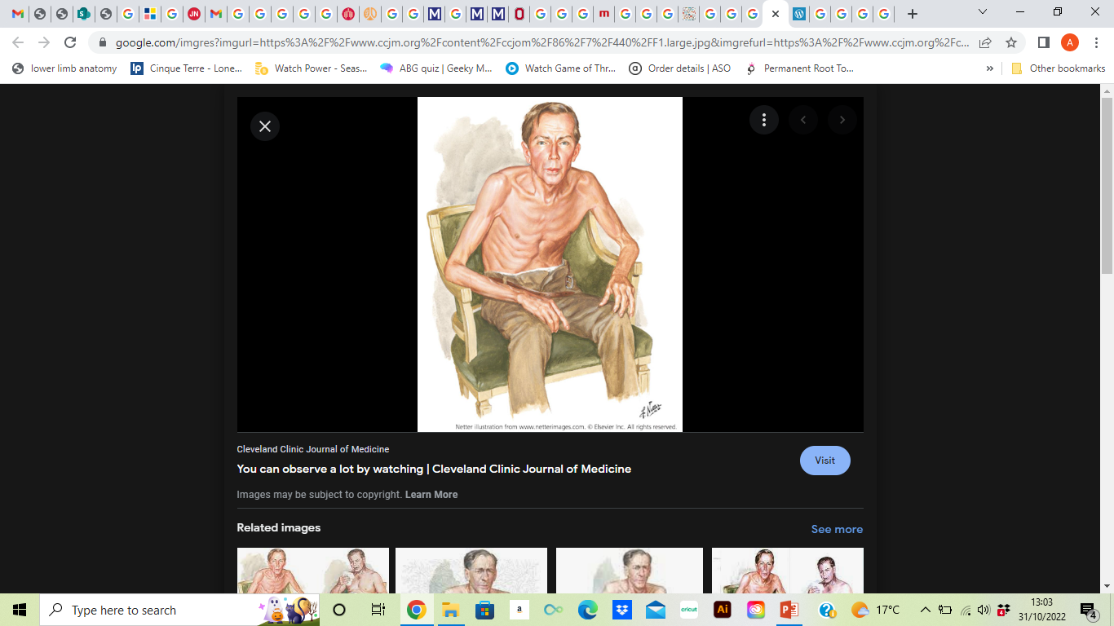
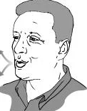
Pursed Lip Breathing
Assessory muscle use
Intercostal in drawing (recession)
Barrel Shaped chest (Hyperinflation)
Forward lean position

Slide 25

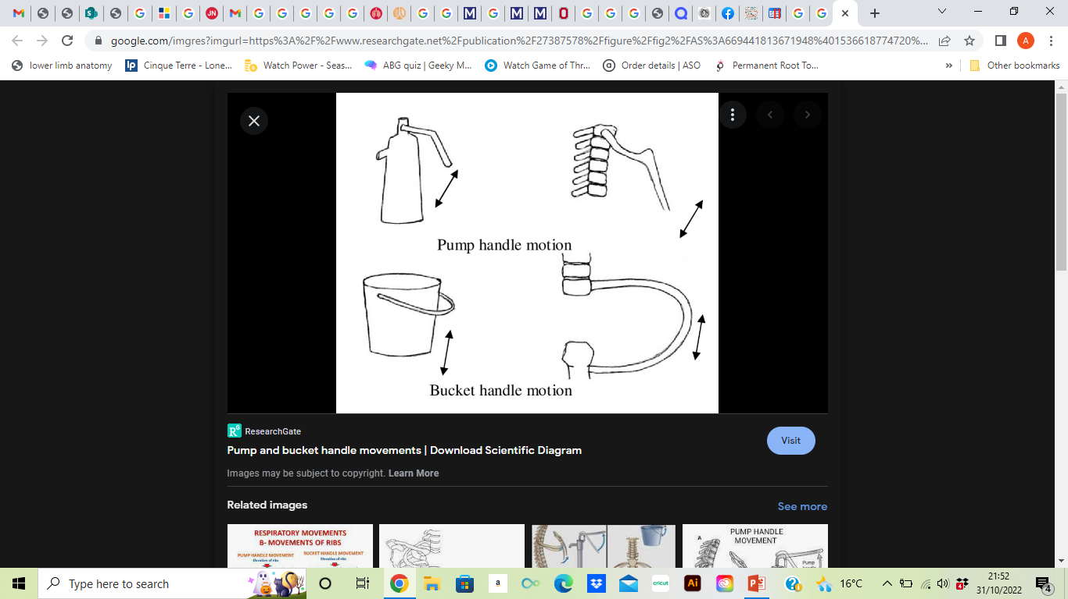
Breathing Assessment: Palpation
Trachea Position
Chest expansion
Palpation > Observation
Reduced movement
Paradoxal movement
  Integrity of chest was is disrupted ie Rib fractures / flail
  Diaphragm paralysis
Feeling for expansion
Hands placed on either side of chest
Feel through normal and deep breath
Consider
How much expansion
Do both sides feel similar?
Notes:
Following a thorough inspection, palpate the thorax to assess for chest wall tenderness or masses, pleural friction or rubs, bronchial and tactile fremitus.17 Tactile fremitus is the vibration felt by resting the palmar surface of each hand on the chest simultaneously and symmetrically and asking the patient to repeat the words ‘ninety-nine’.^{8, 17, 19}
Decreased or absent vibration over an area suggests the presence of fluid or air outside the lung, for example a pneumothorax or a pleural effusion. Increased vibration, however, indicates increased tissue density due to consolidation, lobar collapse, or a tumour.19 Finally, check for chest expansion by bringing thumbs together at the patient’s midline and asking the patient to breathe in

Slide 26
Breathing Assessment: Palpation
Surgical Emphysema
Air within subcutaneous tissues
Chest, neck or face
Characteristic ‘bubble wrap’ feeling under skin
Occurs though surgery, drain insertion or pneumothorax
Tactile Fremitus
Vibrations felt though chest wall
Caused by movement of air around secretions

Slide 27
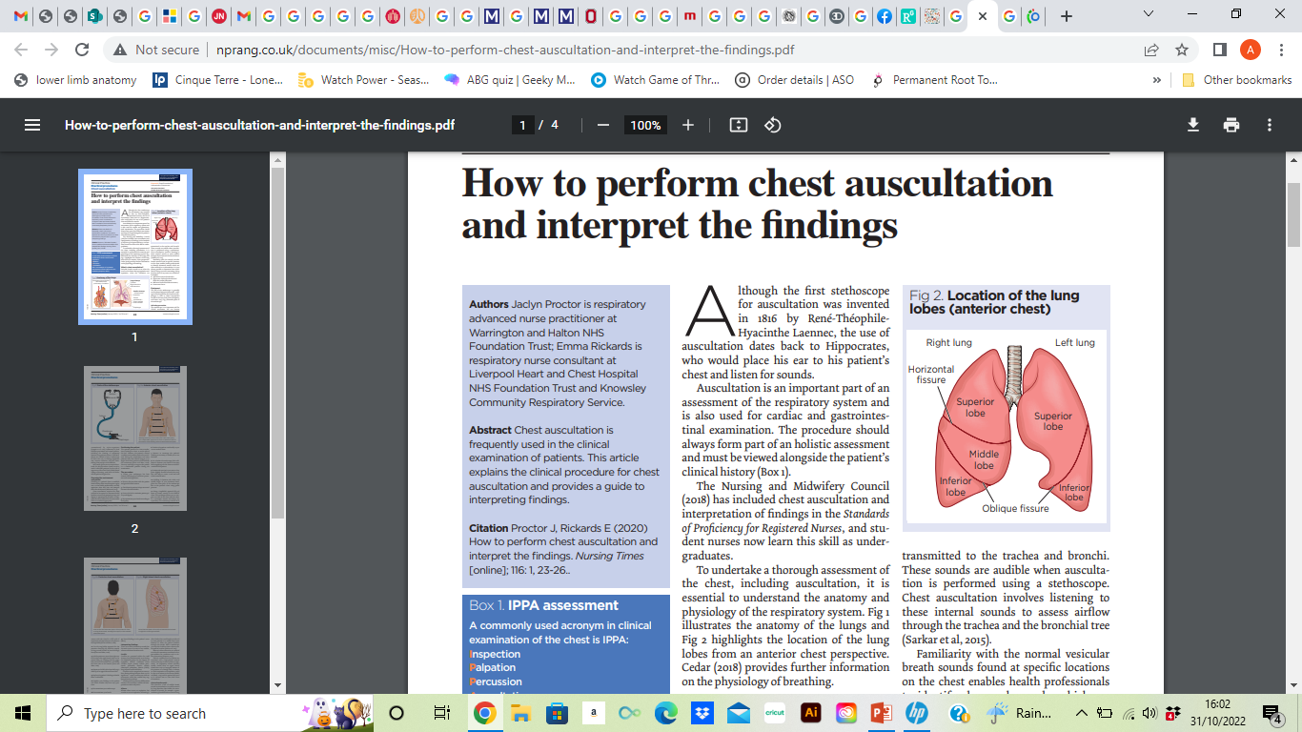
Breathing
Assessment: Listen
Listen
Auscultation
Cough quality
Percussion
Speech

Slide 28
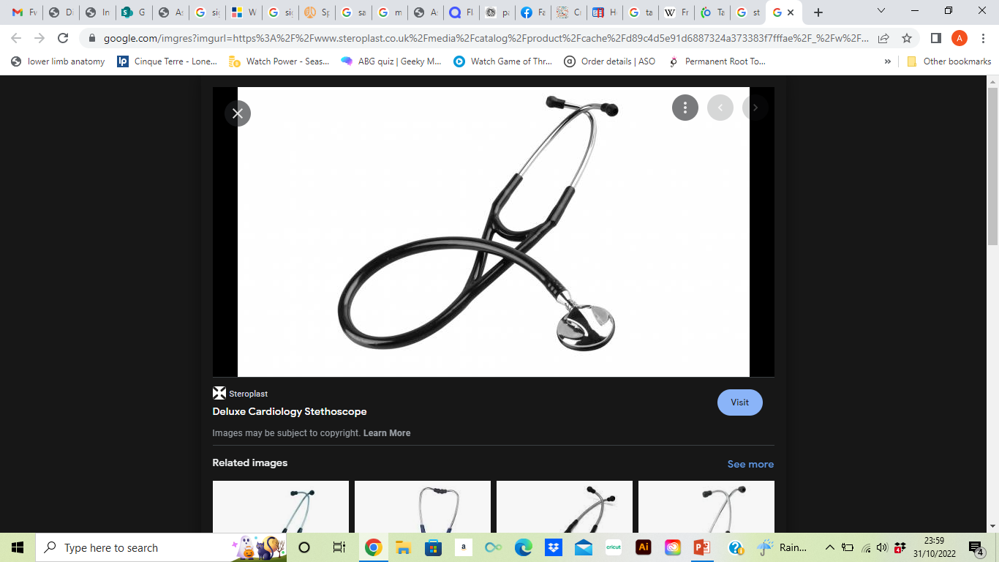
Positioning and handling
* Optimum position: sat in chair / edge of bed
Breathing
Listen
Position patient for comfort and access to anterior and posterior chest
Re-arrange patient clothing to allow access ** with consent
Place against chest using gentle pressure
Instruct patient to take deep breaths through mouth
(Nasal turbulence interferes with breath sounds)
Considerations
Are there any additional sounds?
Are the sounds normal, increased? Or diminished
Listen to each lobe with a systematically
Stepwise approach
Start from top to bottom - Compare right and left side
Repeat posteriorly
Listen throughout inspiration and expiration

Slide 29
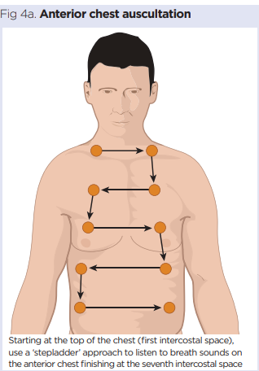
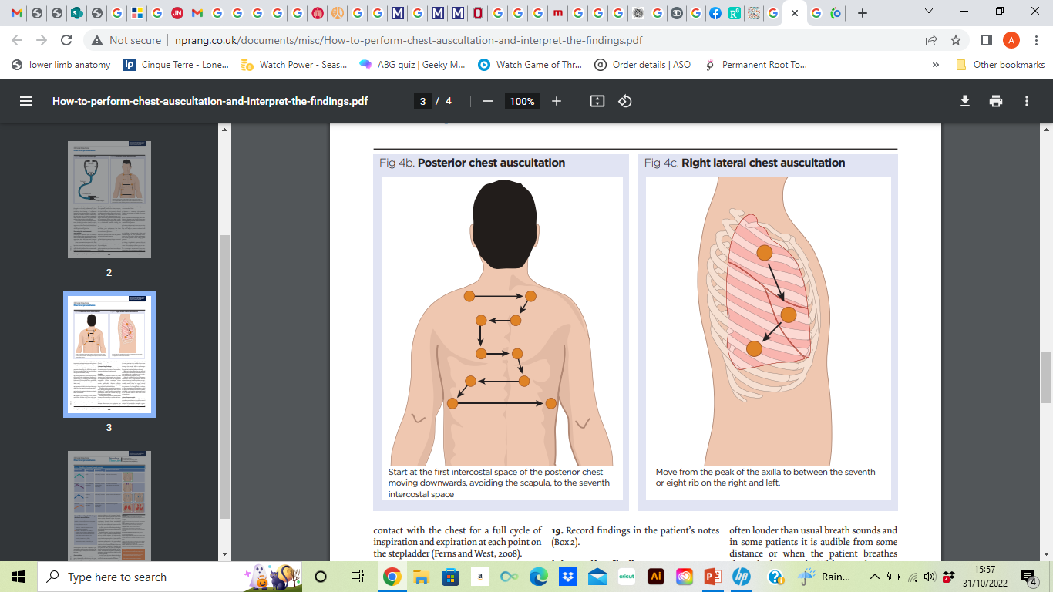
(Proctor J, Rickards E. 2020)

Slide 30
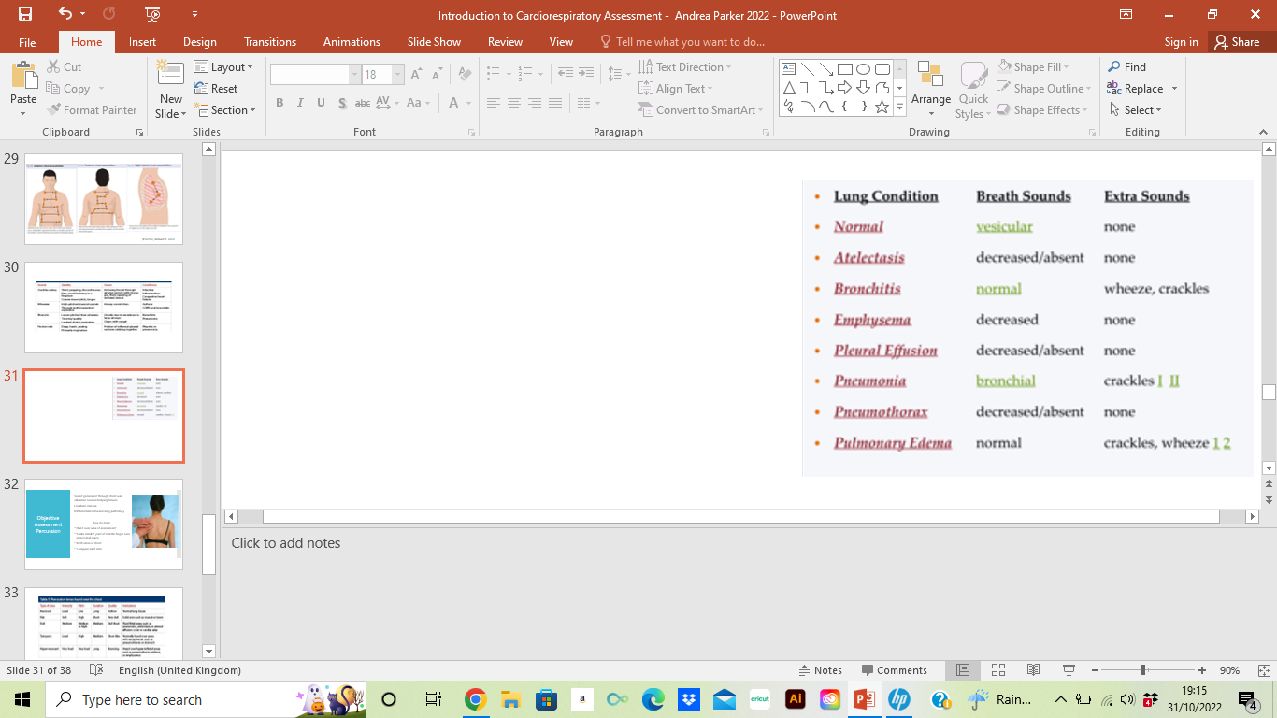

Slide 31

Breathing Assessment: Percussion
Sound generated through chest wall vibration over underlying tissues
Localises disease
Differentiate between lung pathology
How its done:
Hand over area of assessment
Strike distal IP joint of middle finger over intercostal space
Both sides of chest
Compare each side
Notes:
Localisation of l
Healthy Lung: Normal Resonance
Consolidated Lung: Dull
Pleural Effusion: Stony Dull
Pneumothrox / Bullae: Hyper resonance
ung disease
Percussion
Purpsose: To localise lung diease
to discern fluid, air or solid material within the chest cavity
Sound generated chest wall vibrating over underlying tissues

Slide 32
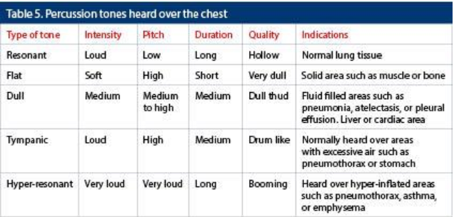
Note: in obesity: healthy lung to sound dull * chest wall unable to move as freely

Slide 33
Objective Assessment: Cardiac
Measure
Heart Rate ( HR) Normal Range:60-100 bpm Tachycardia: >100 bpm Bradycardia: <60 bpm
Blood Pressure (BP) Normal Range 120/80 Hypertension: > 145/95 mmHg Hypotension: < 90/60 mmHg Postural hypotension
ECHO. ECG
Fluid balance
Listen:
Heart sounds can be auscultated – Drs assessment
Palpation
Pulse rate

Slide 34
Objective Assessment:
Disability
Measurement of level of consciousness
Causes of altered consciousness
Hypovolaemia
Hypoxia
Hypercapnia
Metabolic disturbance (e.g. hypoglycaemia)
Seizure
Drug overdose
Opiate usage
National Early Warning Sign (NEWS)
Glasgow Coma Scale (GCS)
Sedation Score ( within ICU )
Notes:
National Early Warning Sign (NEWS)
Glasgow Coma Scale (GCS)
Sedation Score ( within ICU )

Slide 35
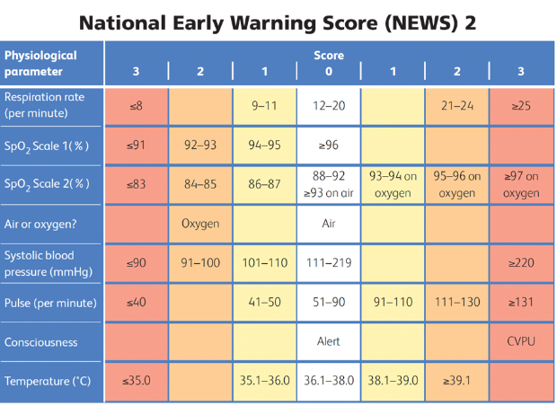
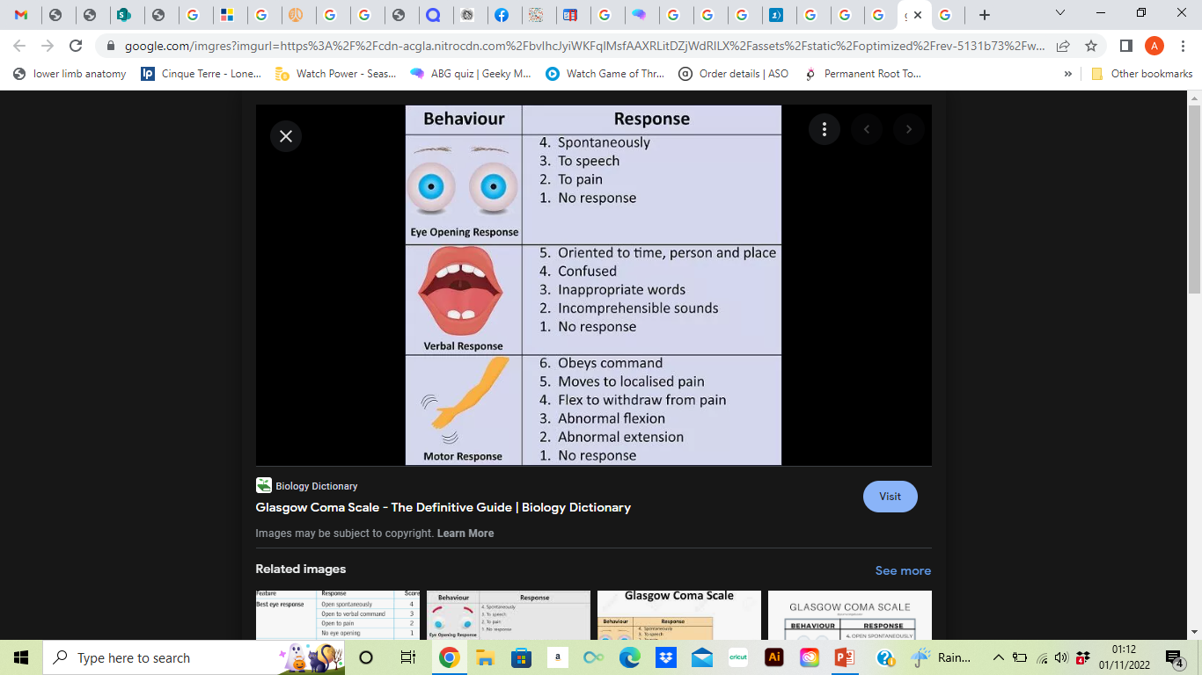
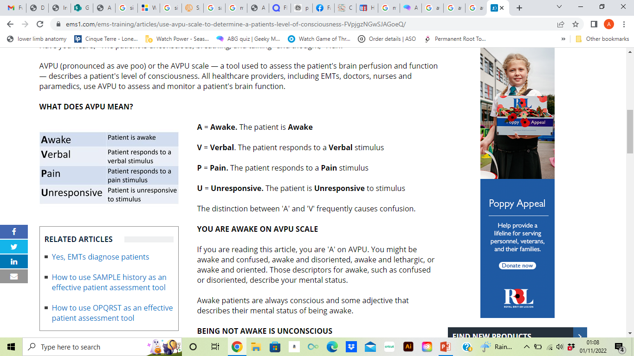

Slide 36
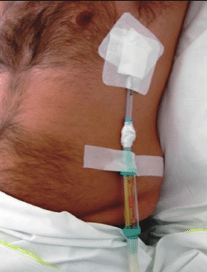
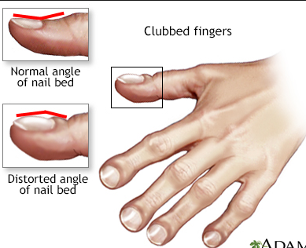
Objective Assessment:
Exposure
Expose skin
Assess for cue to determine extent of illness
Clubbing
Cyanosis
Chest drains
Peripheral oedema

Slide 37

Ensure consent gained before starting assessment
Notes:
verbal consent
Treated in best interest
Parental consent in paeds

Slide 38
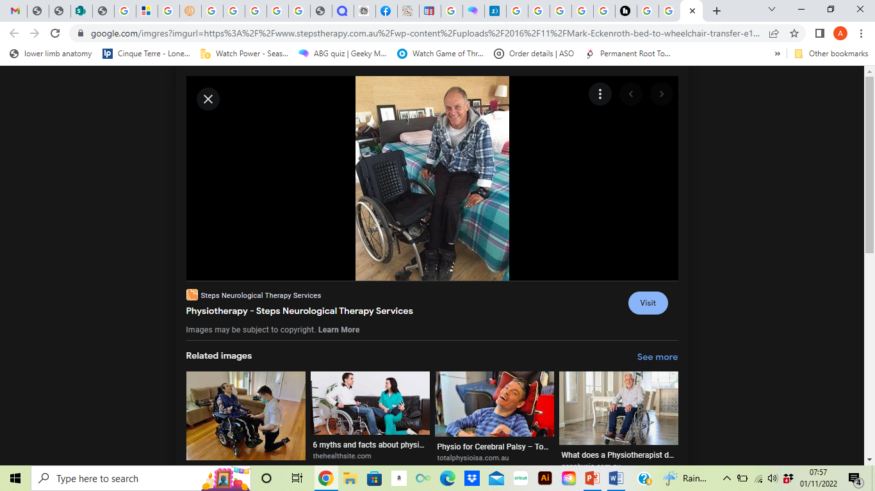
Other Components
Exercise Capacity
Shuttle Walk Test ie 6MWT
Oxygen saturations during exercise
Function
How well do they:
Walk
Complete transfers
Get out of bed
Management of ADLS
MSK/ Neurological
Muscle strength
Sensation / proprioception
Balance

Slide 39


Slide 40
References
Physiotherapy for Respiratory and Cardiac Problems – Pryor & Prasad
Sputum colour: a useful clinical tool in non-cystic fibrosis bronchiectasis ( Murray et al 2019)
Proctor J, Rickards E (2020) How to perform chest auscultation and interpret the findings. Nursing Times [online]; 116: 1, 23-26.
Respiratory Assessment British Journal of Nursing. 15, No. Simpson, H (2016)

